Slide 1
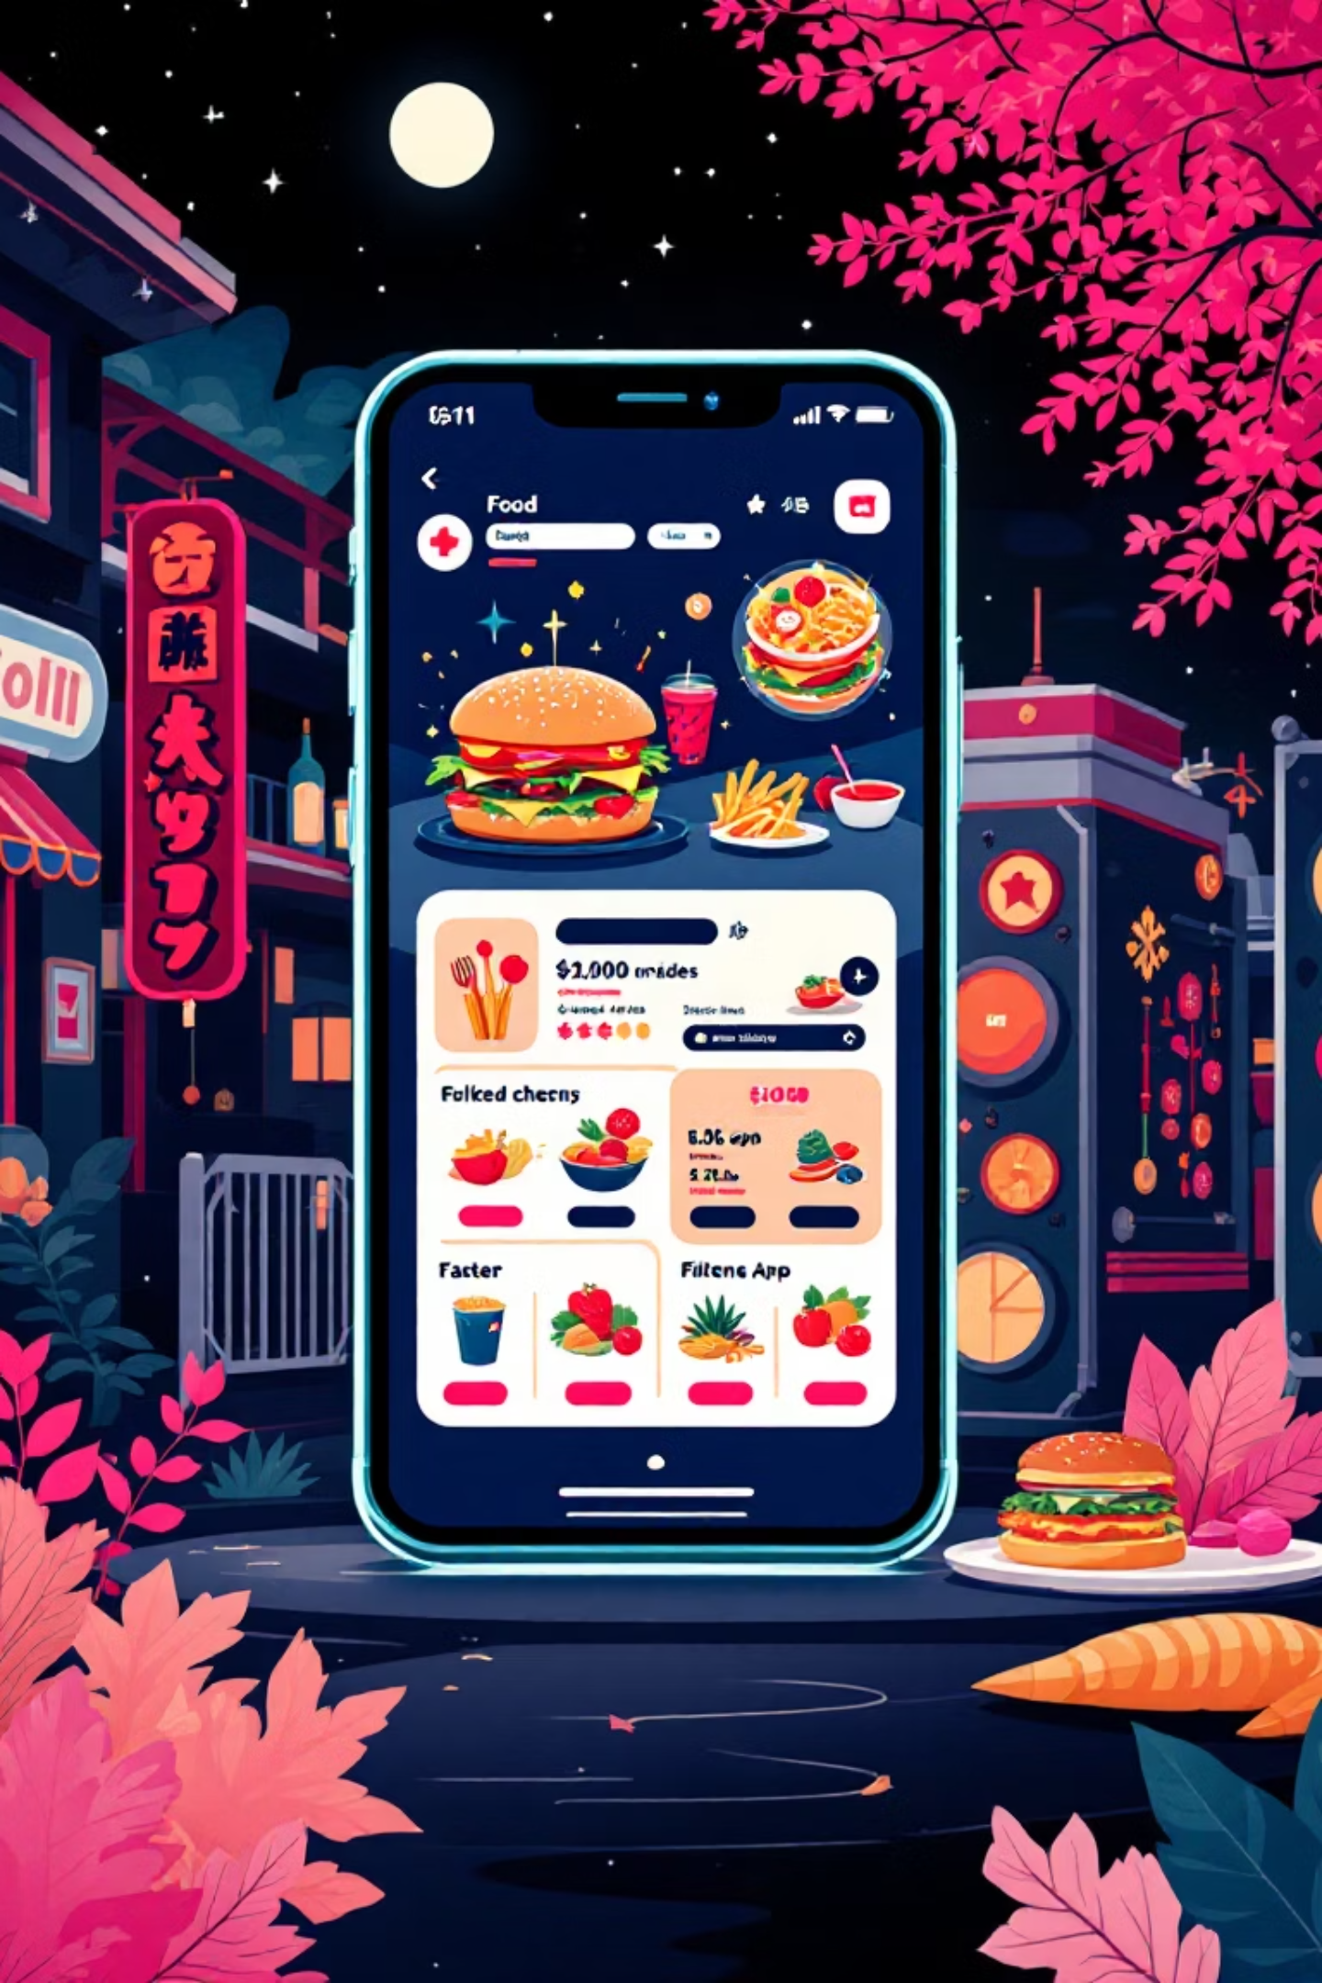
Food Delivery Website (Foodie Delight)
Team Members :
Kazi Hafijur Rahman Rifad | 0242220005101873
MD. Moshiur Rahman | 0242220005101871
MD. Farhan Sadik Shihab | 0242220005101672
MD. Nazmul Kibria Talukder | 0242220005101762
Md. Sajidul Islam | 0242220005101726
PAGE 01

Slide 2

Project Objectives: Crafting a Seamless Experience
Foodie Delight aims to revolutionize food ordering with an intuitive and efficient platform. Our core objectives focus on user convenience and functionality:
Effortless Ordering
Organized Browsing
Provide an easy-to-use platform for quick and hassle-free food selection and checkout.
Offer clear, categorized food browsing to help users find exactly what they crave.
Streamlined Cart Management
Convenient Receipts
Enable intuitive cart management, including quantity updates and transparent bill previews.
Provide flexible downloadable receipt options in both TXT and PDF formats.
PAGE 02

Slide 3
Key Features: Enhancing the User Journey
Our platform is built around a suite of features designed to make the food ordering process enjoyable and efficient from start to finish:
01
02
03
Intuitive Homepage
Dynamic Menu Filtering
Seamless Add to Cart
A welcoming entry point showcasing diverse food categories for easy discovery.
Advanced filtering options to quickly narrow down choices based on dietary preferences, cuisine, or price.
Effortless single-click addition of items to the cart, with immediate visual feedback.
04
05
Interactive Cart Modal
Downloadable Bill Preview
A pop-up cart display allowing users to update quantities, remove items, and see real-time totals.
Full transparency with a detailed bill preview, offering convenient TXT/PDF download options.
PAGE 03

Slide 4




Robust Technology Stack: The Engine Behind Foodie Delight
Foodie Delight is engineered with a modern and efficient technology stack, focusing on a responsive and dynamic user experience:
Frontend Excellence
Built with HTML, CSS, and JavaScript for a highly interactive and engaging user interface.
Scalable Backend
Leveraging a robust backend (to be specified) to manage orders, user data, and inventory efficiently.
Development Environment
Developed using VS Code for streamlined coding, debugging, and collaboration.
PAGE 04

Slide 5



Navigating Development Challenges: Our Strategic Approach
Building a seamless food delivery platform comes with its unique set of challenges. We've identified key areas and strategies to overcome them:
Responsive UI
Ensuring the interface adapts flawlessly across all devices, from desktops to mobile phones, for a consistent user experience.
Cart State Management
Implementing efficient state management to handle real-time updates of cart contents, quantities, and totals without glitches.
User-Friendly Design
Crafting intuitive and aesthetically pleasing pages that guide users effortlessly through the ordering process, minimizing friction.
PAGE 05

Slide 6
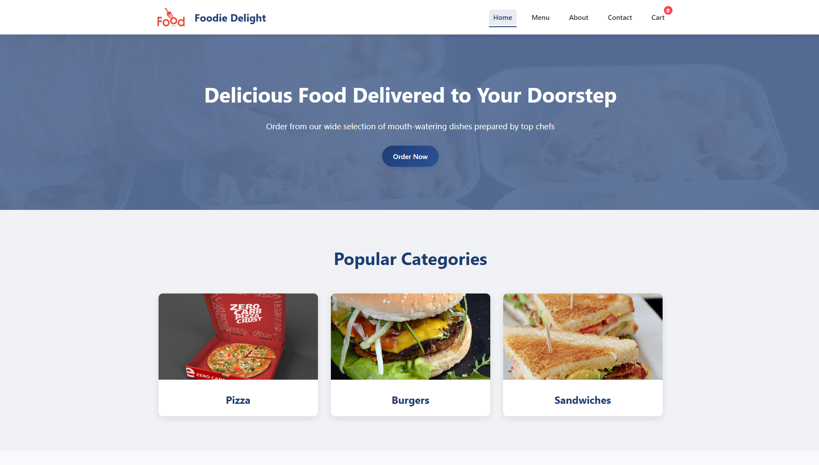
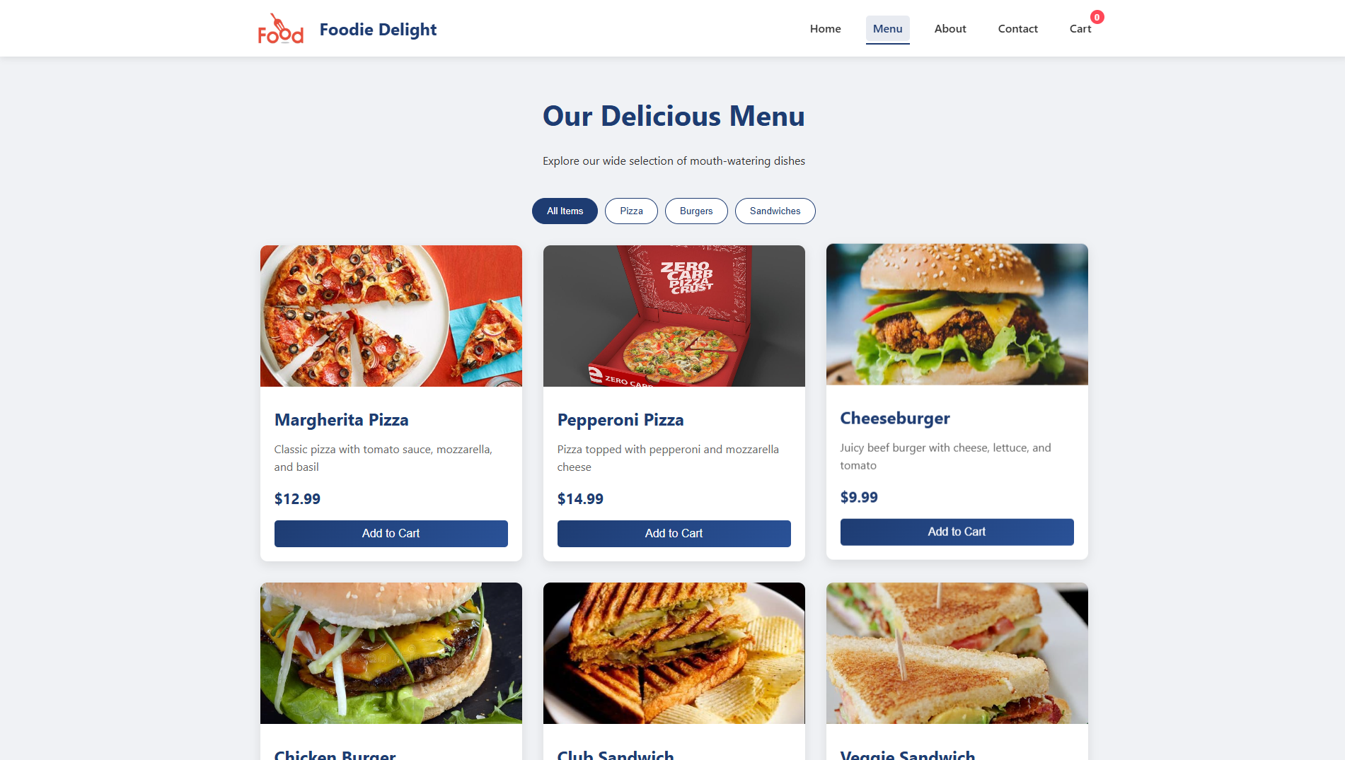
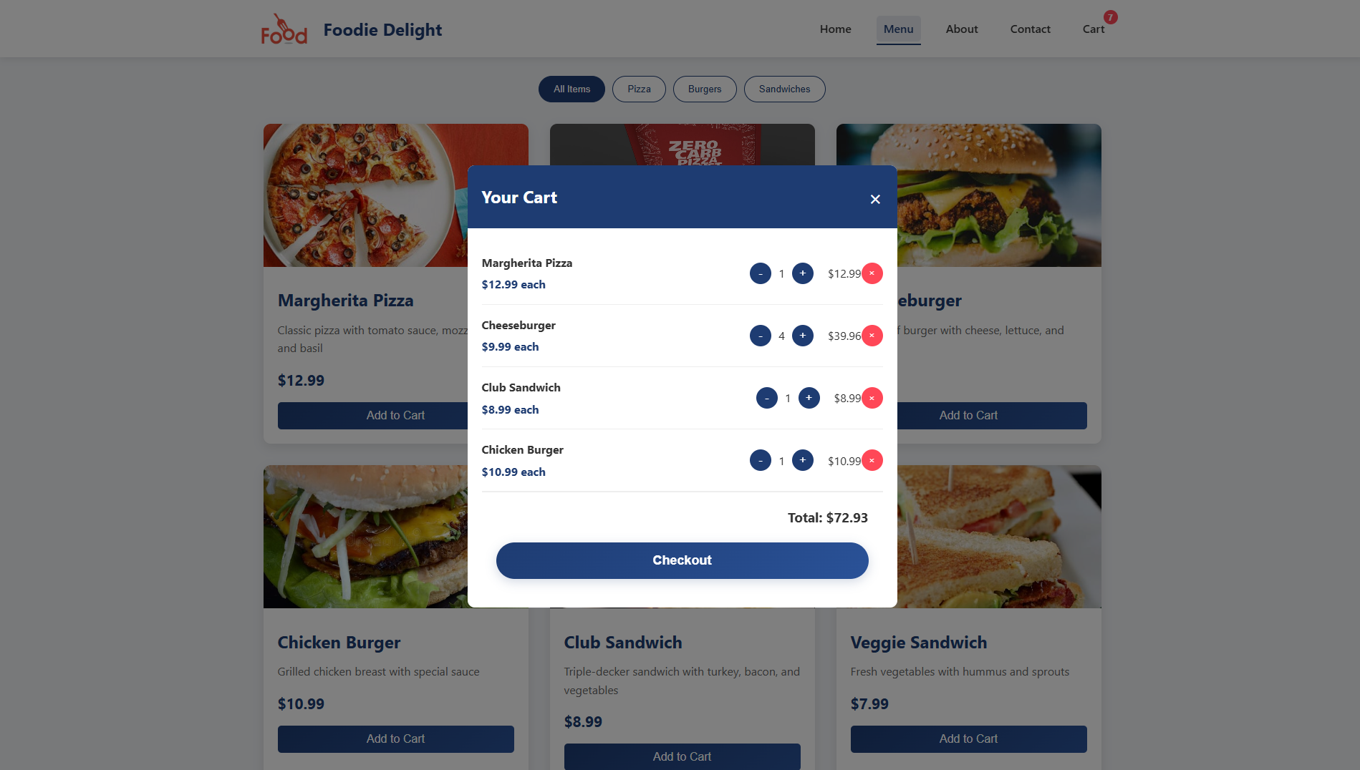
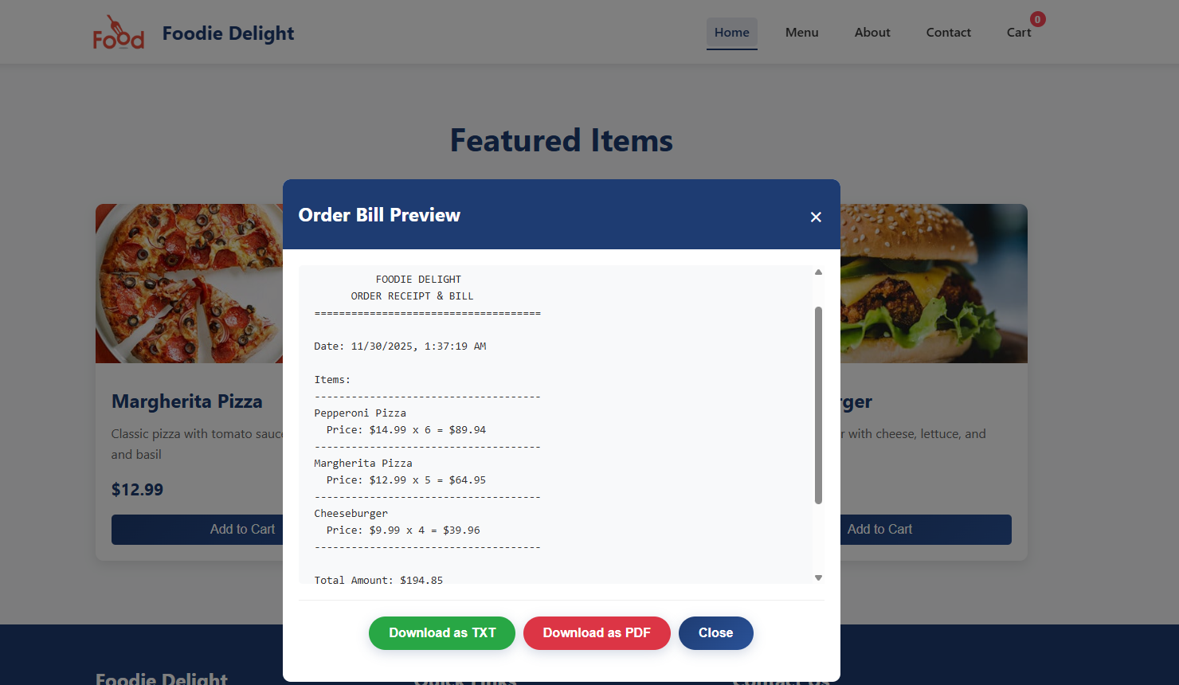
System Interface Preview :
PAGE 06

Slide 7




Future Improvements: Expanding Foodie Delight's Potential
We envision Foodie Delight continually evolving to meet user needs and market demands. Our roadmap for future enhancements includes:
Online Payment Integration
Seamlessly integrate various payment gateways for secure and convenient transactions directly within the app.
User Accounts & Order History
Implement user registration, login, and personalized order history for a more tailored experience.
Real-time Delivery Tracking
Provide users with real-time updates and GPS tracking of their orders from kitchen to doorstep.
PAGE 07

Slide 8
Thank You for Your Time!
Foodie Delight – Your Next Favorite Food Delivery Experience
We appreciate your interest in the Foodie Delight project. We're excited about the potential to bring this user-centric food delivery platform to life!
PAGE 08

